Slide 1
Team 10A: Automatic Lego Sorting Machine
Team Members: Abdullah, Fahad , Sultan, Abdulaziz and Husain
Roles: Alternating roles

Slide 2

Project Description
Description of the project:
  Build a machine that sort Lego by size and functionality.
Sponsor/client:
  NAU, Dr. David Welly
Importance of the project:
  Skills and knowledge.
  Time and effort.
Figure 1: Lego [1]
Fahad Alotaibi
Notes:
Hi,everyone we are team 10A and our project is Automatic Lego Sorting Machine, My name is Fahad ….. Team Role is alternating Role.
The description of out project is to design,build and test a machine that sort Legos by size and functionality.
The sponsor of the project is NAU and the client is Dr David Welly.
Importance of the project:
Skills and knowledge: experience to develop our engineering skills and knowledge.
Time and effort: reduce time and effort that we spend on sorting legos

Slide 3
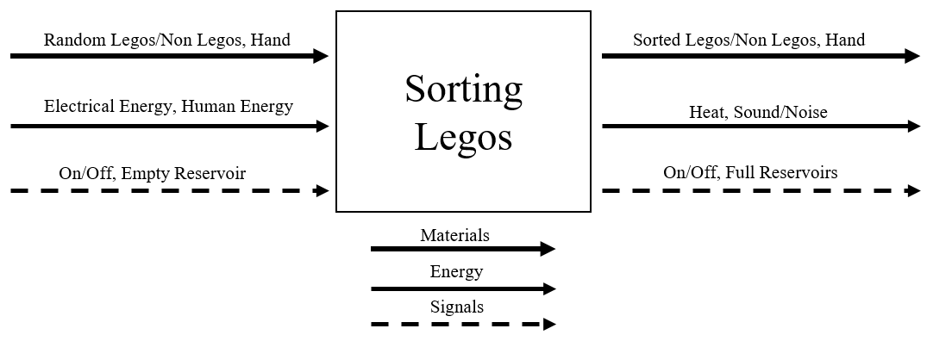
Functional decomposition
Black Box
Figure 2: Black Box
Sultan Alharbi

Slide 4


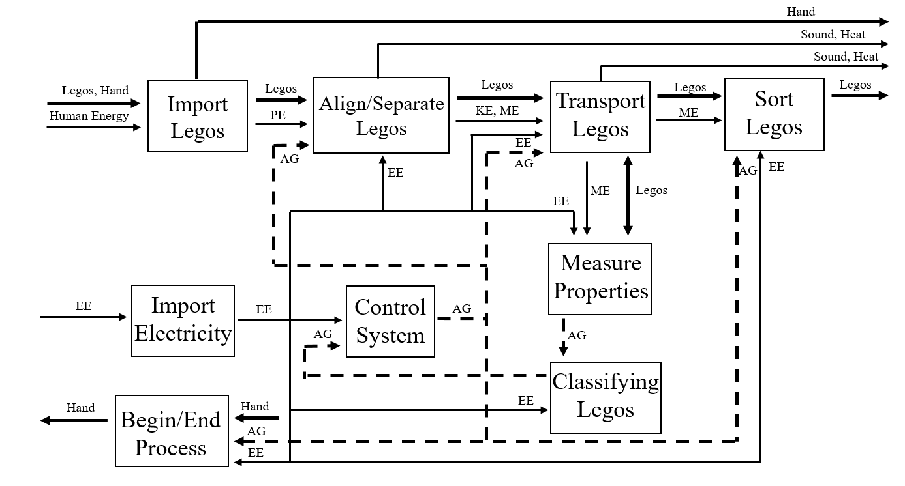
Functional decomposition
Figure 3: Decomposition model
Sultan Alharbi

Slide 5
Design Description

Slide 6
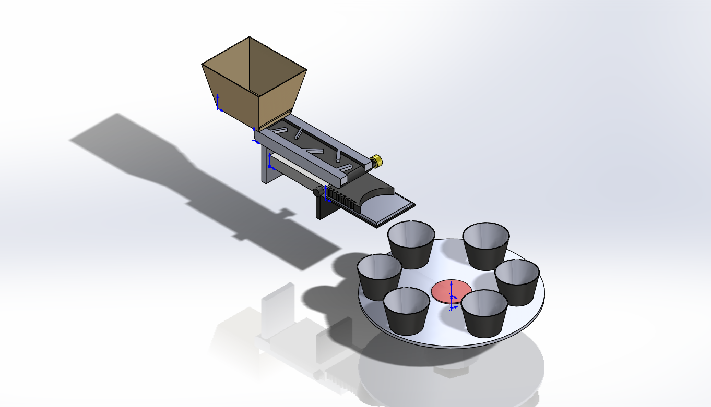
CAD Model
Figure 4: Final CAD model
Abdullah Almutairi

Slide 7
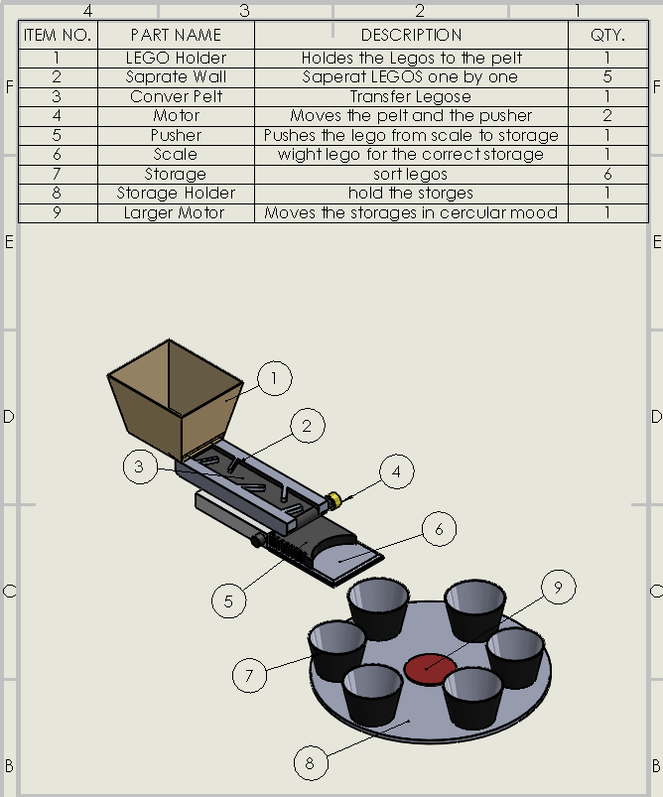
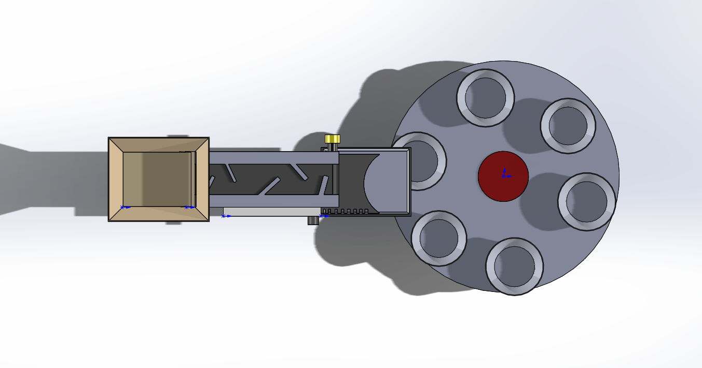
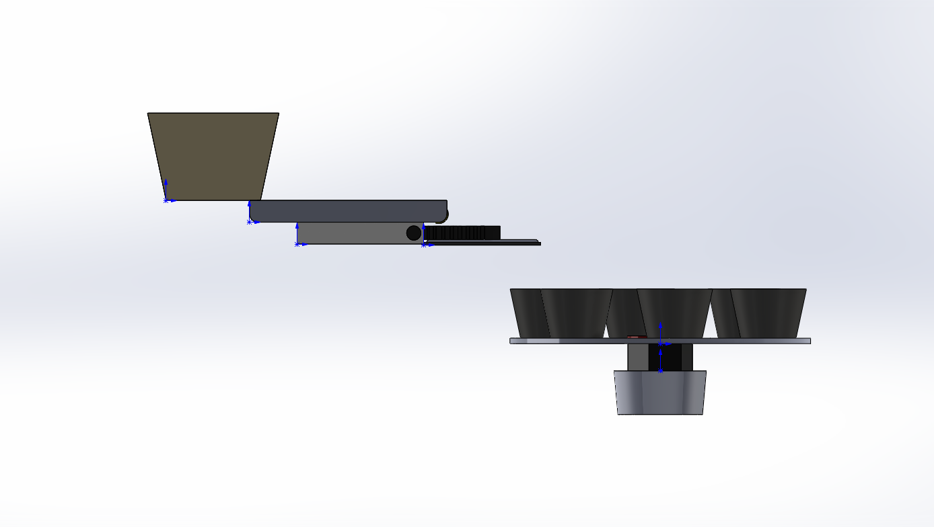
CAD
Figure 5: Top view
Figure 7: Detailed CAD
Figure 6: Side view
Abdullah Almutairi

Slide 8
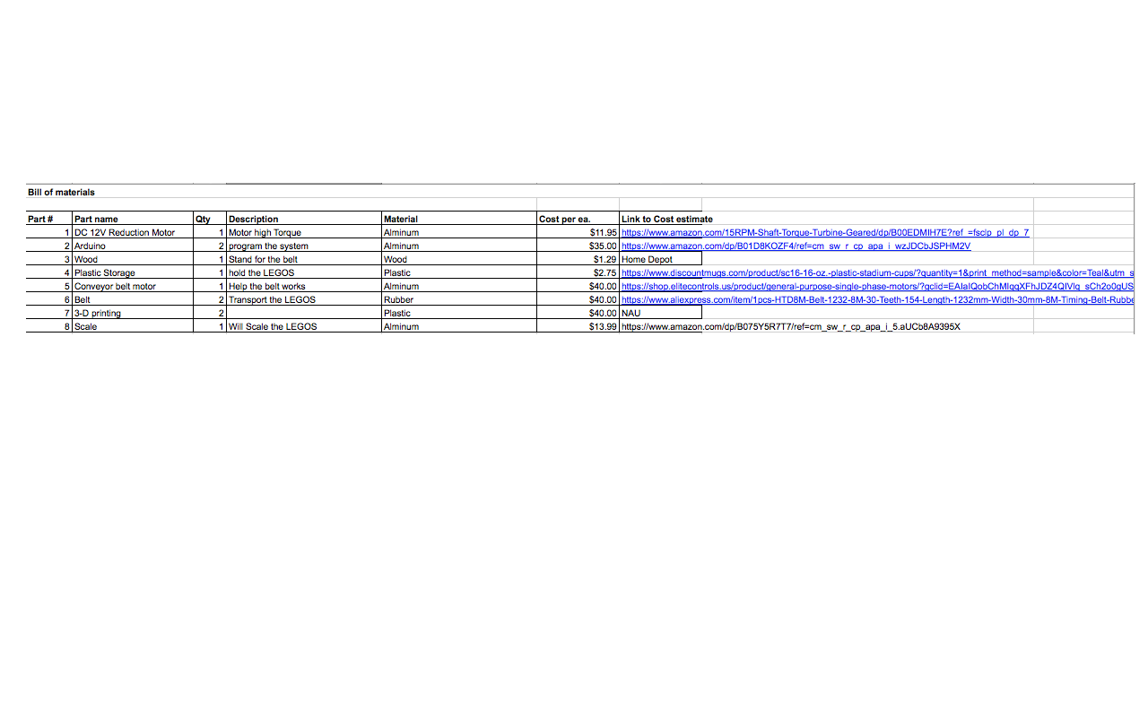
BOM
Table 1: Bill of materials
Abdulaziz Almaimony

Slide 9
Analyses Summary

Slide 10
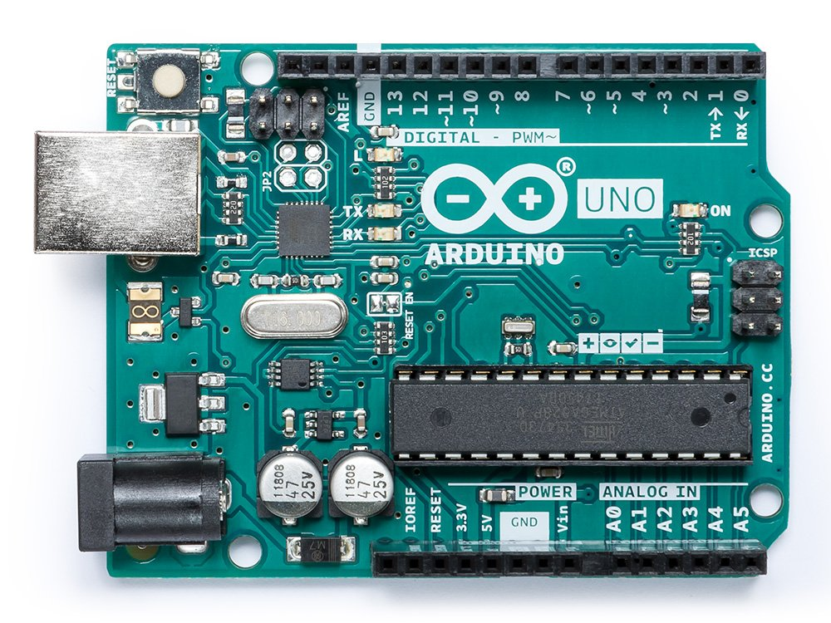
Arduino
What is Arduino?
  Definition
  Types
What does it do for our project?
  Using programming
How it work in our project?
  Algorithms
  Arduino IDE [9]
Figure 8: Arduino [8]
Abdullah Almutairi

Slide 11
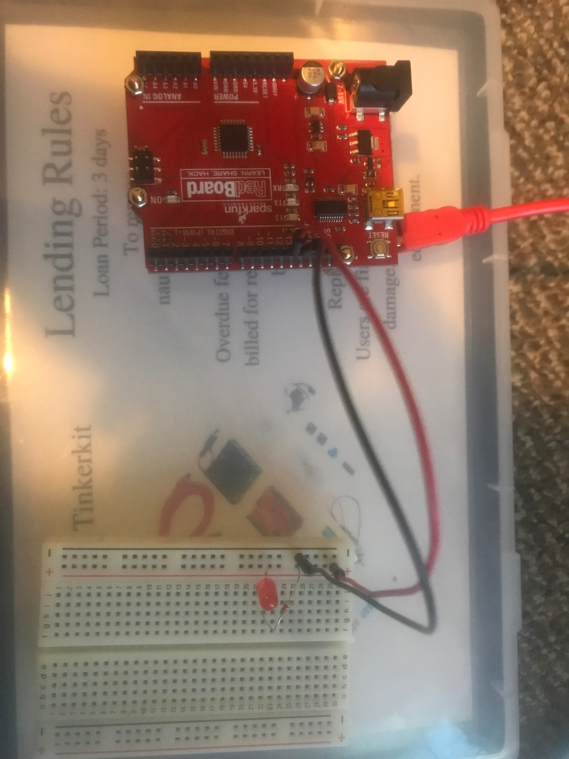
Example - Blink
// the setup function runs once when you press reset or power the board
void setup() {
// initialize digital pin LED_BUILTIN as an output.
pinMode(LED_BUILTIN, OUTPUT);
}
// the loop function runs over and over again forever
void loop() {
digitalWrite(LED_BUILTIN, HIGH); // turn the LED on (HIGH is the voltage level)
delay(1000); // wait for a second
digitalWrite(LED_BUILTIN, LOW); // turn the LED off by making the voltage LOW
delay(1000); // wait for a second
} [10]
Figure 9: Arduino
Abdullah Almutairi

Slide 12
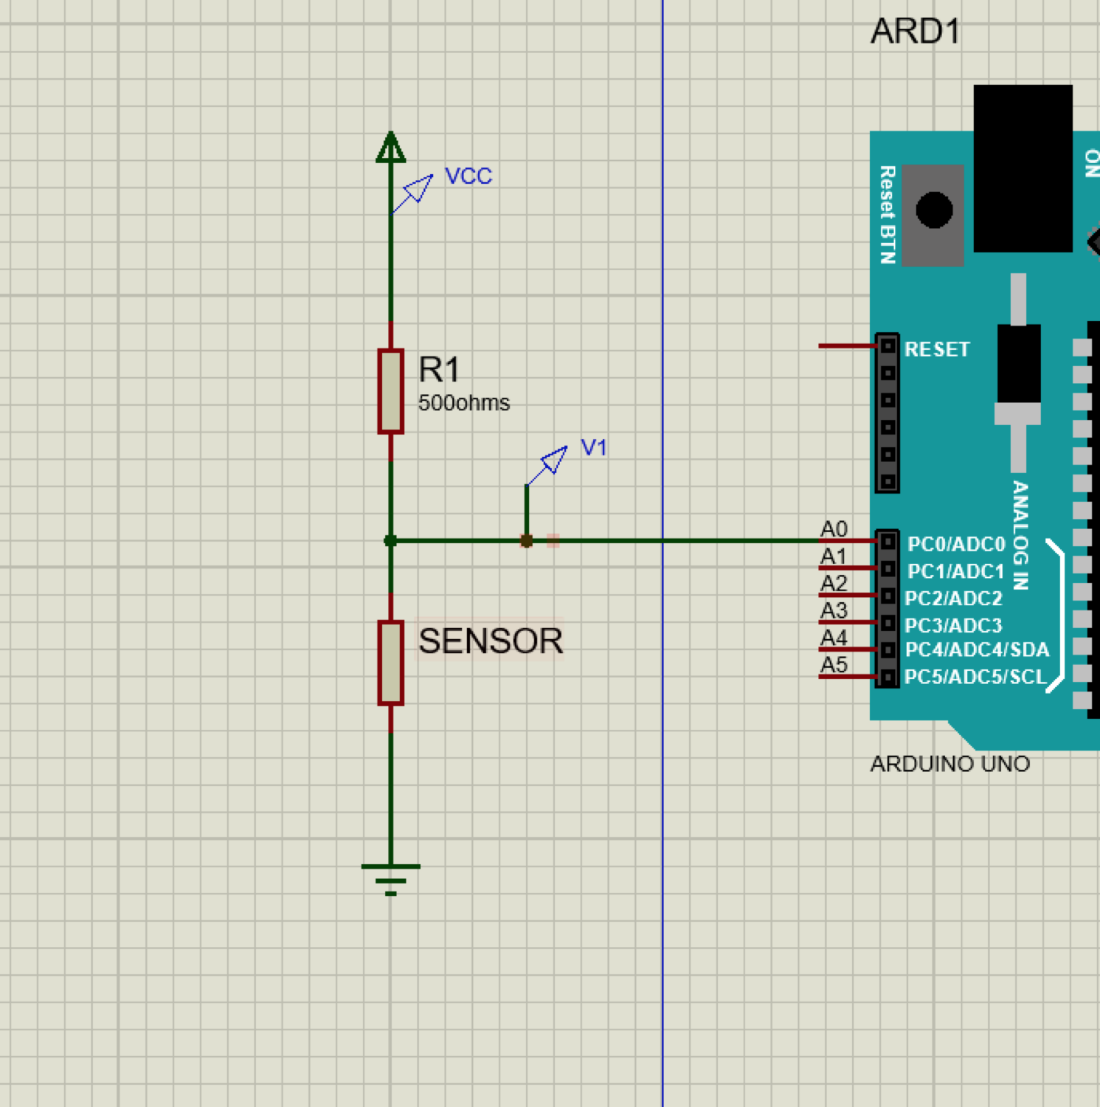
Scale Hacking + Arduino
Problem: Weight Measurements of Lego pieces.
Procedure:
  Sending information from sensor (load cells)
  Voltage Drop (output)
  Arduino connected to the sorting mechanism
  Pins motors turns
Figure 10 : Arduino/sensor diagram
Husain Alkandari

Slide 13
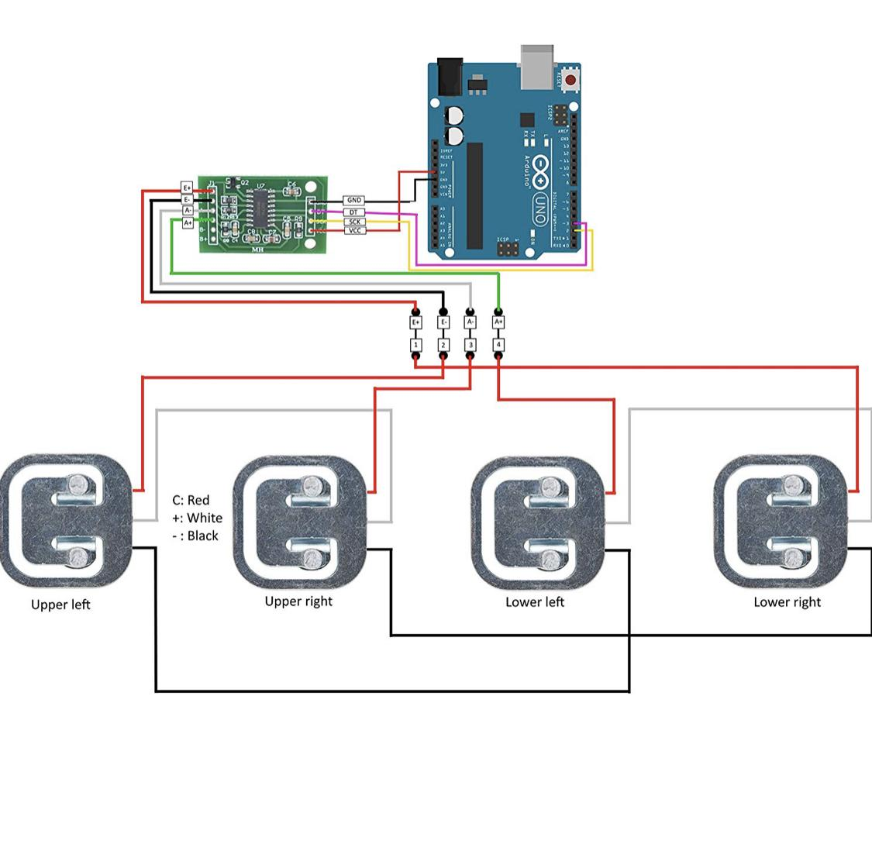
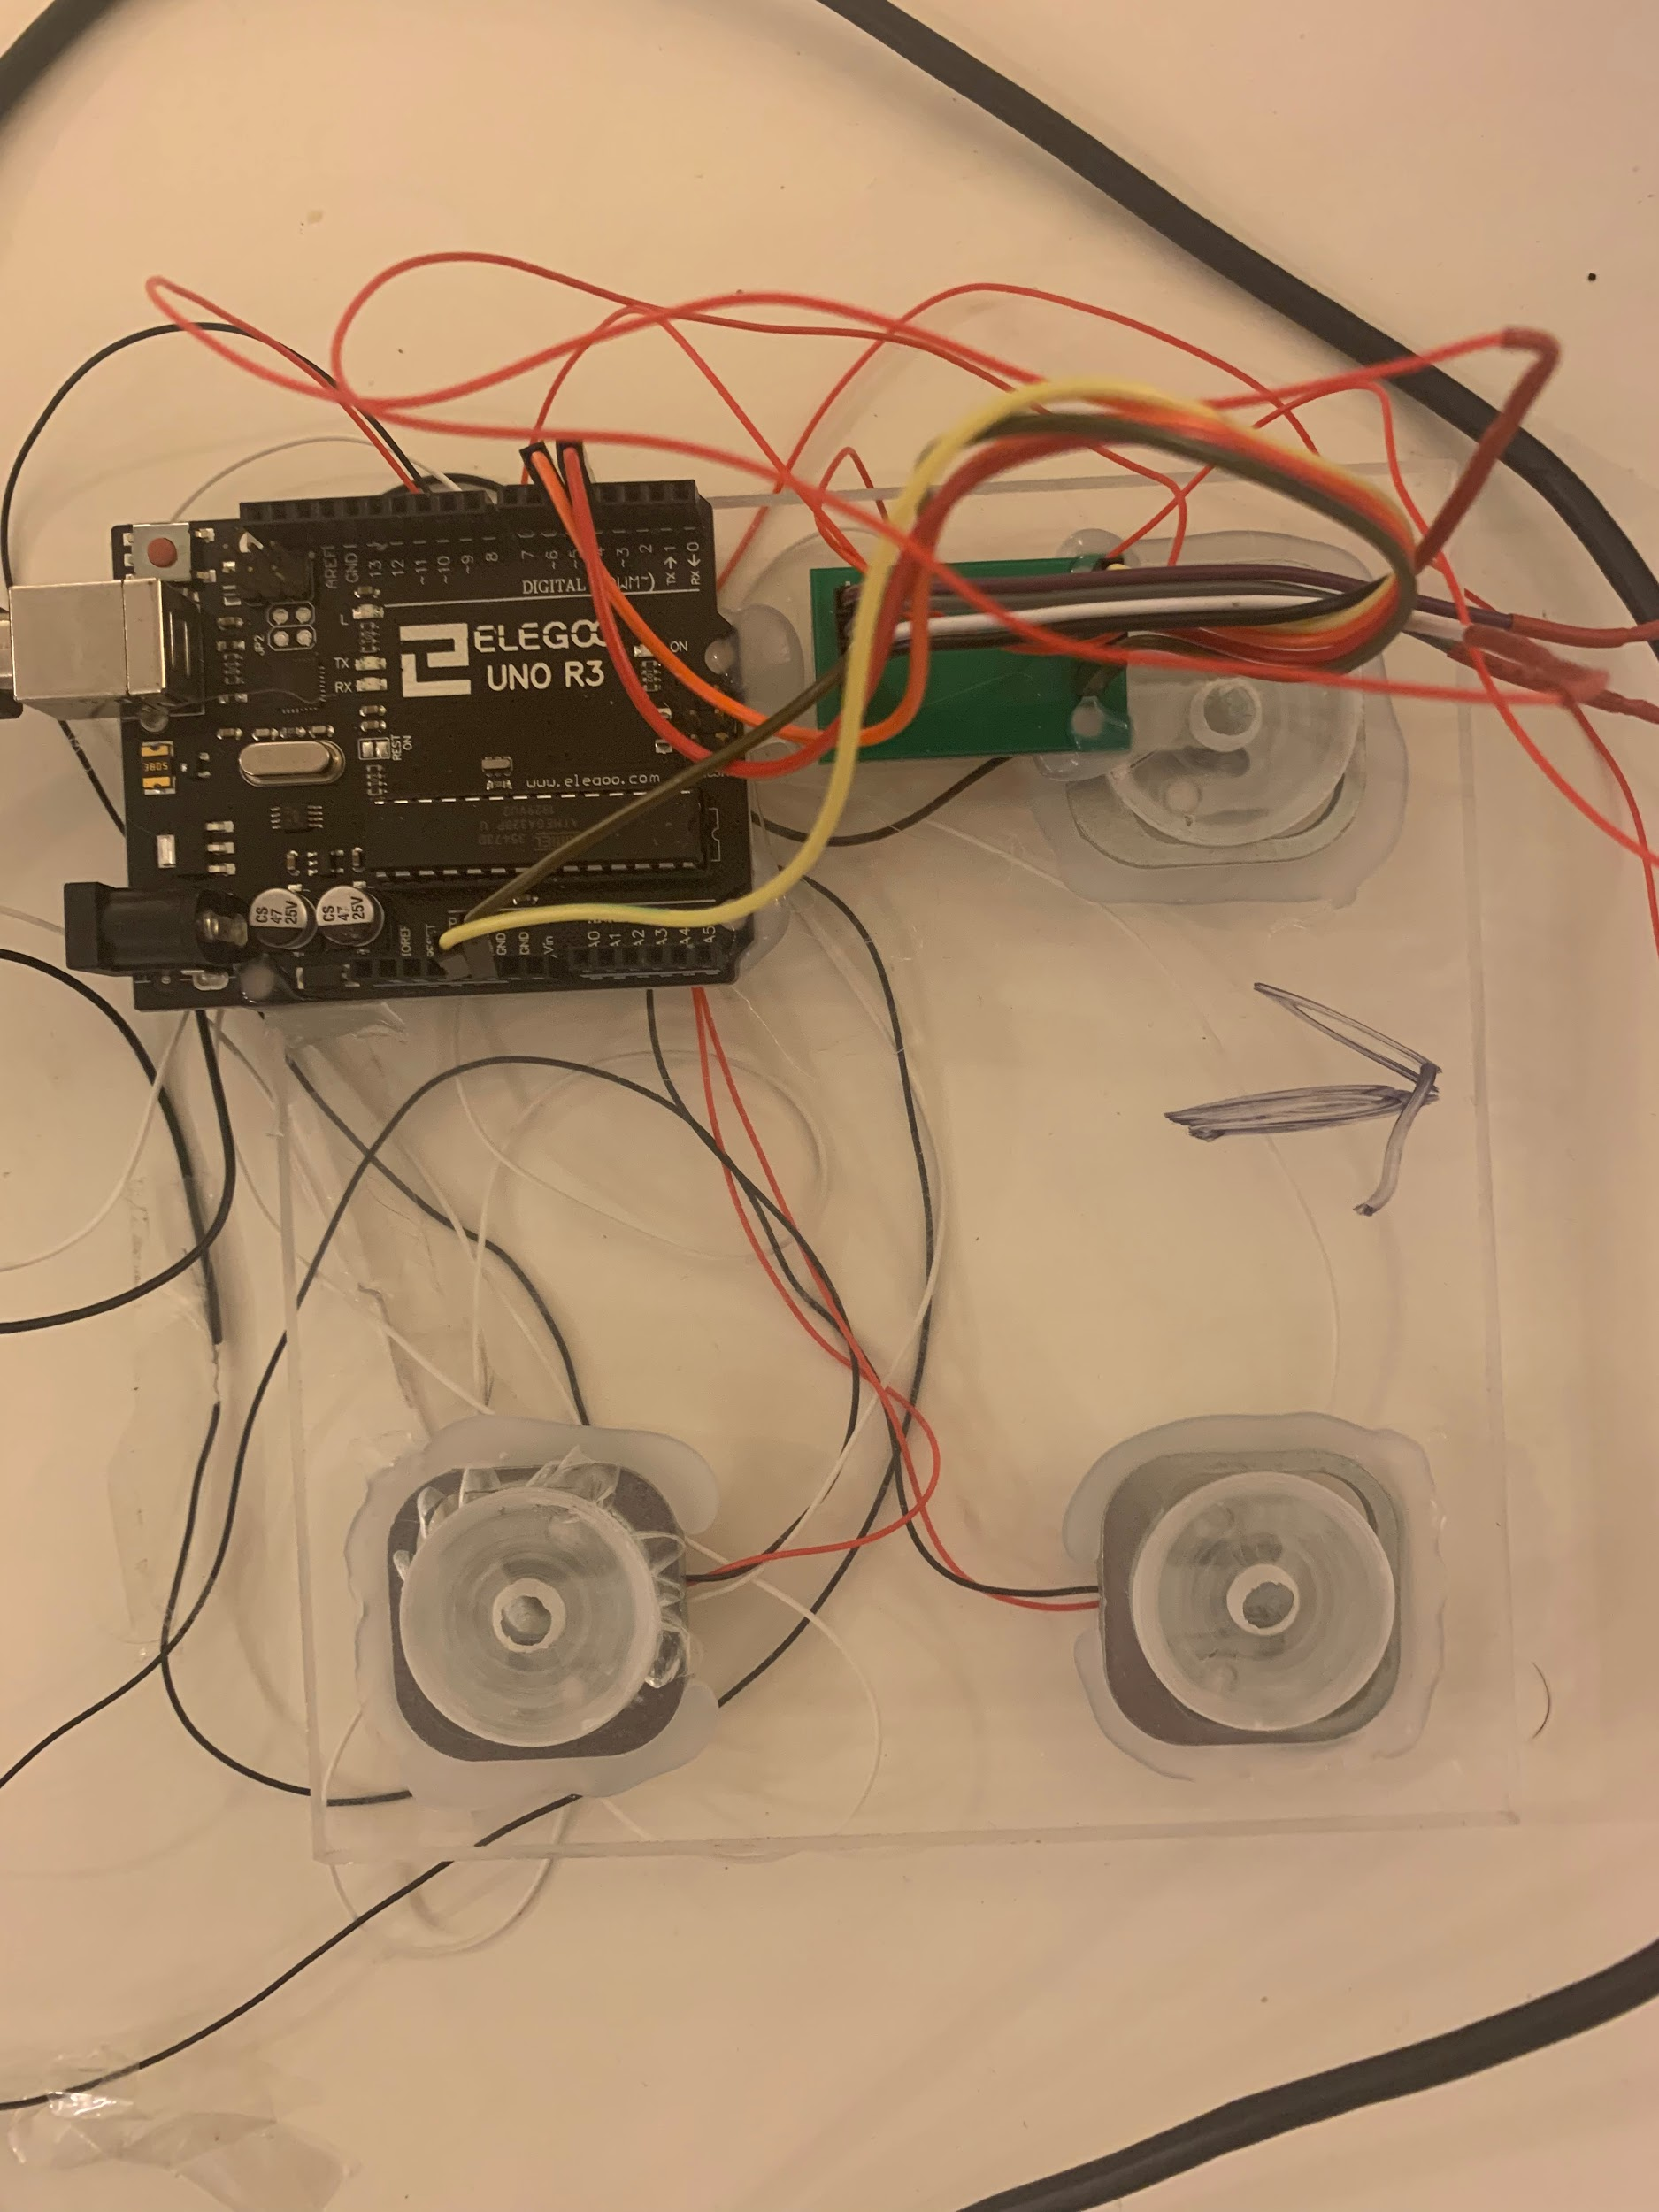
Figure 11: Load Cells
Figure 12: Load cell on reality
Husain Alkandari

Slide 14
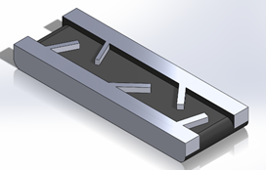



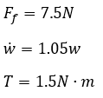
Conveyor belt
Assumptions
  There is no friction between the and the belt.
  The size of the conveyor belt is 22” X 11”.
  Weight on the conveyor belt will be divided equally at all the points.
Equations
Figure 13: Conveyor belt
Sultan Alharbi

Slide 15
Sorting Mechanism
Knowing the weight of legos from part three
  Rest it to start point.
  Rotate the motor to the right bin.
Bins
  Each bin holds 5 legos.
  Bins size.
Motor ( Actuator )
  DC 12V Reduction Motor Worm Reversible High Torque Turbo Geared Motors 2-100RPM [F2]
  Cost of this motor is $11.59 [F2]
Fahad Alotaibi
Notes:
The legoes have different dimensions long, short, and between and also have light weight. The sorting will depends on the weight of each lego.
By knowing the type of lego that is coming from the weight scale in part three in project , the motor will rotate the bins till it match the right bin.
We will have 6 bins since we are sorting 6 types of lego. Each bin will holds at least 5 legos and to calculate the volume of each bin by knowing the volume of largest lego. Each bin will be 5 in length, 4 in width ,and 6 in height.
For the motor since the speed needed is 5 to 10 rpms is enough, and the torque is around 20 Nm and the cost of such motor is around $12.
Two-phase reduction gear motor with encoder.
Long service life, low noise, large torque.
Stable and reliable performance.
Can rotate and reversal, work more accurate.

Slide 16
Customer Requirements
Separate Legos (10)
Safety (10)
Cost (8)
Portable design (8)
Easy to assemble (7)
Longlife (7)
Husain Alkandari

Slide 17
Customer Requirements
Separate Legos:
  Scale precise readings
Safety:
  Fully enclosed system
Portable:
  Base and handles
Longlife:
  Motors and conveyor belts
  Scale
Husain Alkandari

Slide 18
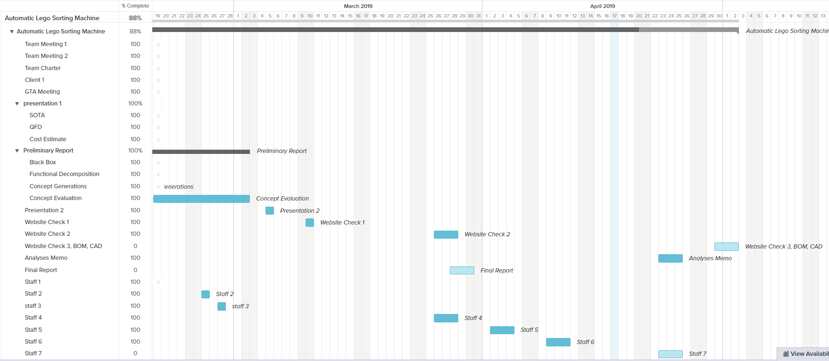
Schedule & Budget
Abdulaziz Almaimony

Slide 19
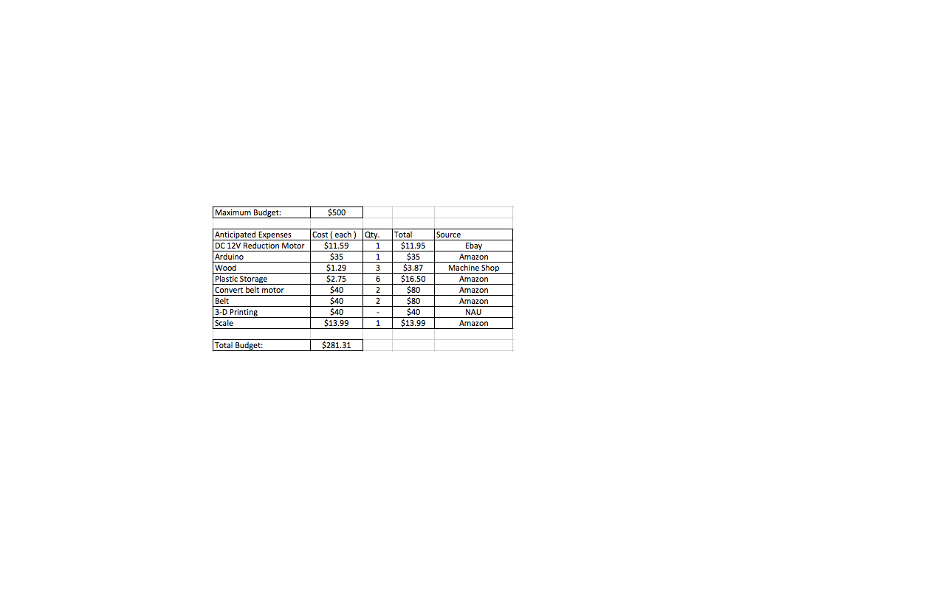
Budget
Table 2: Budget
Abdulaziz Almaimony

Slide 20
Conclusion
Result Summary
Acknowledge Achieved
Abdullah Almutairi

Slide 21
[1] Pymnts, “Everything Is Not Awesome As LEGO Sales Decline,” PYMNTS.com, 08-Mar-2018. [Online]. Available: https://www.pymnts.com/news/retail/2018/lego-toys-r-us-toy-industry-sales/. [Accessed: 02-Feb-2019].
[2]Ebay, “Motor High Torque”, available [online], https://www.ebay.com/itm/DC-12V-Reduction-Motor-Worm-Reversible-High-Torque-Turbo-Geared-Motors-2-100RPM-/232964282593
[3] MONK, SIMON. Programming Arduino: Getting Started with Sketches. Mcgraw-Hill Education, 2016.
[4] Amazon.com. (2019). Amazon.com: Online Shopping for Electronics, Apparel, Computers, Books, DVDs & more. [online] Available at: https://www.amazon.com/ [Accessed 5 Mar. 2019].
[5] BrickLink, BrickLink - Minifig poc007 : Lego Blackbeard [Pirates of the Caribbean] - BrickLink Reference Catalog. [Online]. Available: https://www.bricklink.com/catalogTree.asp?itemType=P. [Accessed: 03-Mar-2019].
References

Slide 22
References
[6] Martin, Fred G. "The art of LEGO design." The Robotics Practitioner: The Journal for Robot Build rs 1.2 (1995): 1-19.
[7] “ARDUINO UNO R3 [A000066],” Amazon. [Online]. Available: https://www.amazon.com/Arduino-A000066-ARDUINO-UNO-R3/dp/B008GRTSV6. [Accessed: 04-Mar-2019].
[8] Softschools.com. (2019). Distance Speed Time Formula. [online] Available at: http://www.softschools.com/formulas/physics/distance_speed_time_formula/75/ [Accessed 5 Mar. 2019].
[9] Google Search. [Online]. Available: https://www.google.com/search?q=arduino&source=lnms&tbm=isch&sa=X&ved=0ahUKEwiOgKSKq7_hAhWPY98KHbs9DVMQ_AUIESgE&biw=897&bih=607&dpr=2#imgrc=Z7Y7cYxr-WooxM: [Accessed: 08-Apr-2019].
[10] S. I. M. O. N. MONK, Programming arduino: Getting started with sketches. New york: Mcgraw-hill education, 2016.
[11] “Home,” Arduino. [Online]. Available: https://www.arduino.cc/. [Accessed: 08-Apr-2019].

Slide 23
Thank You,
Questions?

